Slide 1

E-MENU: DON'T WAIT JUST PRE-ORDER
BY TEAM THE REAL ONE
-OASIS PAUDEL
-PRANJAL ARYAL

Slide 2
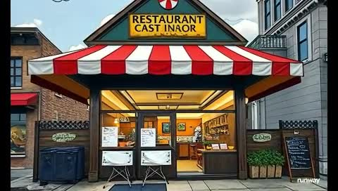
WHAT IS E-MENU?
DIGITAL ORDERING
TIMELY ORDER
Customers can choose a desired arriving time, ensuring their food is ready when they arrive at the restaurant.
PERSONALIZED EXPERIENCE
E-menu allows customers to save their preferences, favorite dishes, and payment information
for faster ordering.
E-menu is a website that enables customers to browse menus, customize orders, and submit pre-orders directly from their devices.

Slide 3

HOW DOES E-MENU WORK?
BROWSE MENU
Customers can view the restaurant's full menu, including item descriptions and photos, on the e-menu site.
ARRIVE
When the customer arrives at the restaurant, they don’t have to wait and will be served pre-ordered food at the restaurant.
1
2
3
PLACE ORDER
Customers select their desired items, customize their order, and submit the pre-order through the site.

Slide 4
BENEFITS
ADVANTAGES FOR CUSTOMERS:
TIME SAVING
Customers can avoid long wait times and enjoy a seamless dining experience by pre-ordering their meals.
CUSTOMIZATION
E-menu allows customers to personalize their orders, ensuring their preferences are met.
CONVENIENCE
With the ability to pre-order, customers can better manage their schedules and enjoy a stress-free meal.
ADVANTAGES FOR RESTAURANTS:
IMPROVED EFFICIENCY
STREAMLINES OPERATIONS BY REDUCING WAIT TIMES AND OPTIMIZING KITCHEN WORKFLOWS.
REDUCED ERRORS:
Minimizes order inaccuracies through direct customer input.
HIGHER REVENUE:
Encourages more orders by minimizing delays .

Slide 5
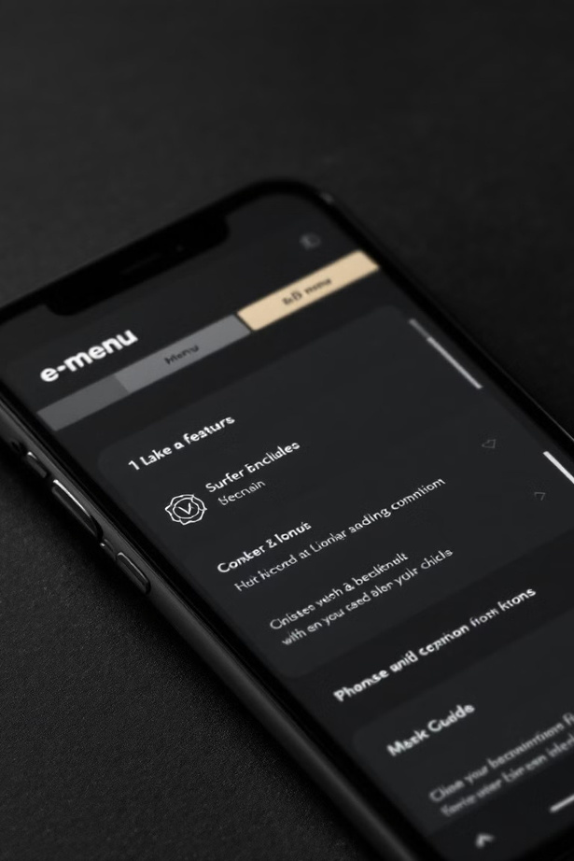

KEY FEATURES OF E-MENU
DIGITAL MENUS
Browse and explore full digital menus with item descriptions and photos.
PRE-ORDERING
Place orders and choose a desired pickup time to skip the wait.
SECURE PAYMENTS
Securely store payment information for faster checkout.
AI BOT
A chat bot through customers can search about what they are about to eat.

Slide 6
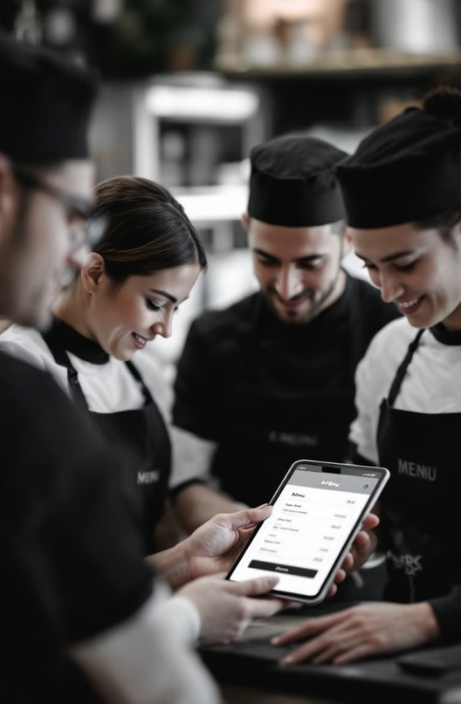
INTEGRATING E-MENU WITH RESTAURANTS
ONBOARDING
Our team will guide you through the seamless integration of E-menu with your restaurant's existing systems.
1
MENU OPTIMIZATION
We'll help you create a visually appealing and user-friendly digital menu to showcase your offerings.
2
STAFF TRAINING
Provide your staff with comprehensive training to ensure they can effectively manage pre-orders and provide a superior customer experience.
3

Slide 7

DRIVING CUSTOMER ADOPTION OF E-MENU
1
2 3
ONLINE PROMOTION
Prominently display E-MENU signage and instructions to encourage customers to use the website
PHYSICAL PROMOTION
By visiting certain restaurants to set up our product and advertise.
REFERALS
Leverage word-of-mouth to amplify brand awareness and drive customer engagement.

Slide 8
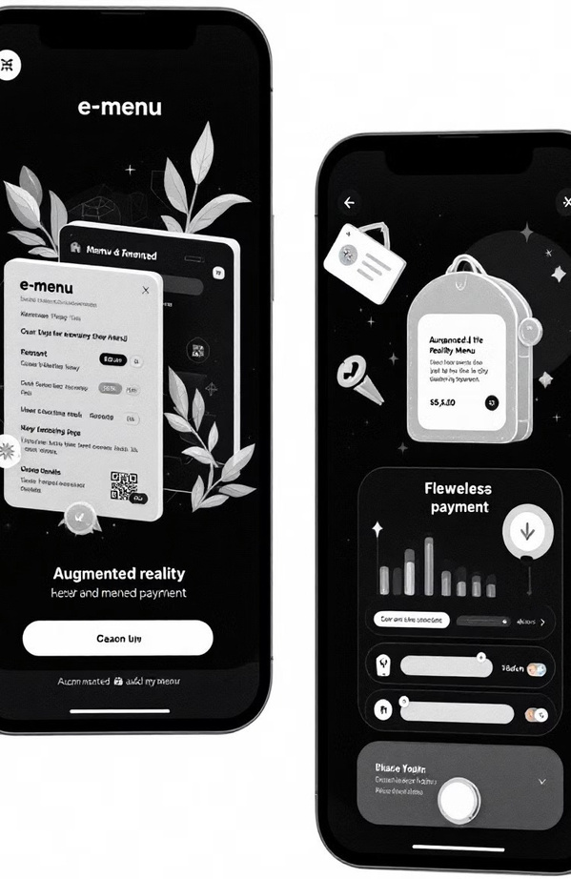
FUTURE ROADMAPS
CONTACTLESS ORDERING
Seamless integration with mobile wallets and contactless payment methods for a completely touchless
experience.
PERSONALIZED RECOMMENDATIONS
Intelligent AI-powered suggestions based on customer preferences and past orders.
EXPANDED PARTNERSHIPS
Collaborations with delivery services and other platforms to provide a comprehensive dining solution.

Slide 9
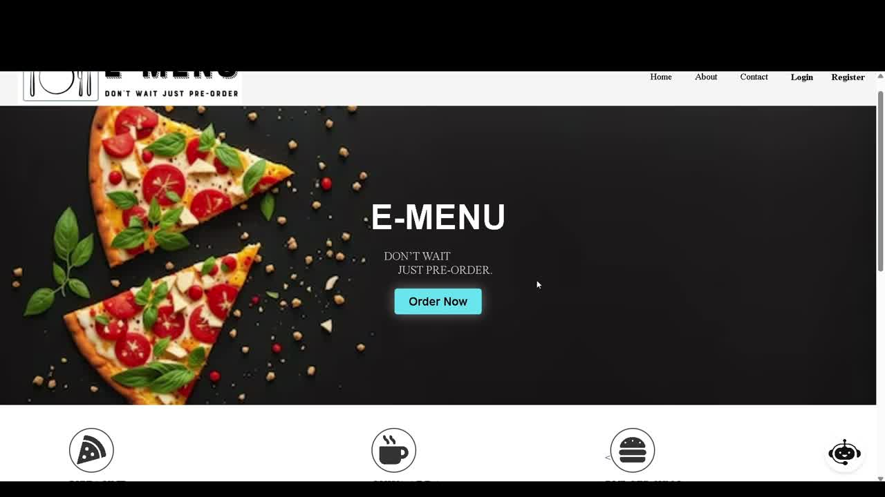
PROJECT DEMONSTRATION

